Slide 1

English for Telephoning
Class: 18C1-NNA1
Time: 14.10 – 15.40 on
Lecturer: Ms. Nguyen Thi Thanh Tu
Faculty of Foreign Languages
Ly Tu Trong College of Ho Chi Minh City
Unit 3: Let me get back to you on that (cont.)

Slide 2
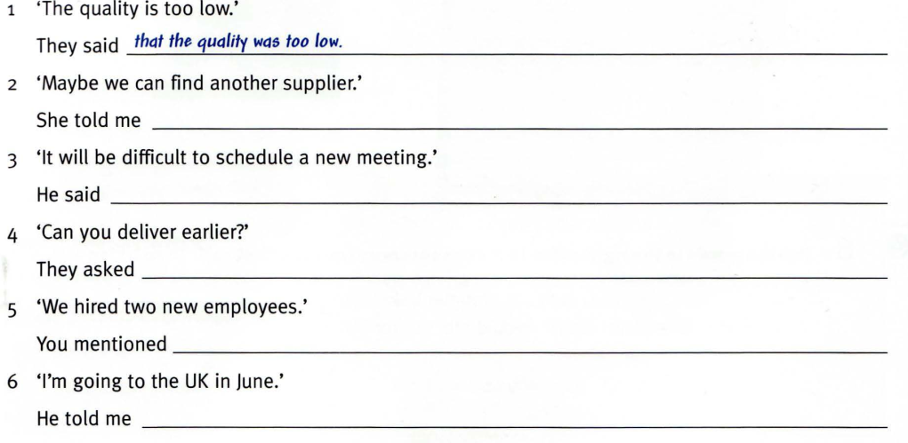
7. Complete the reported sentences, as in the example

Slide 3
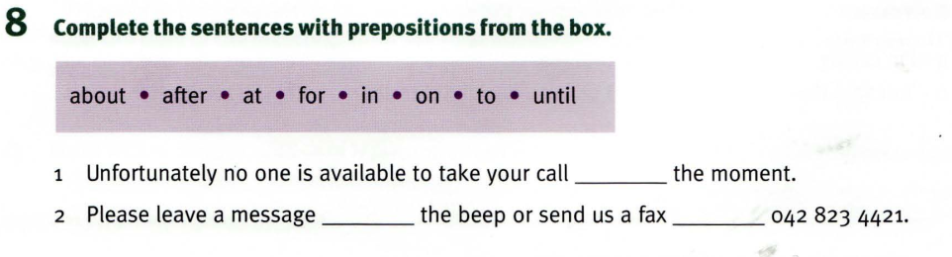
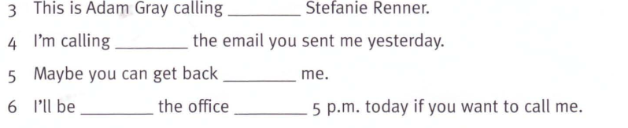

Slide 4
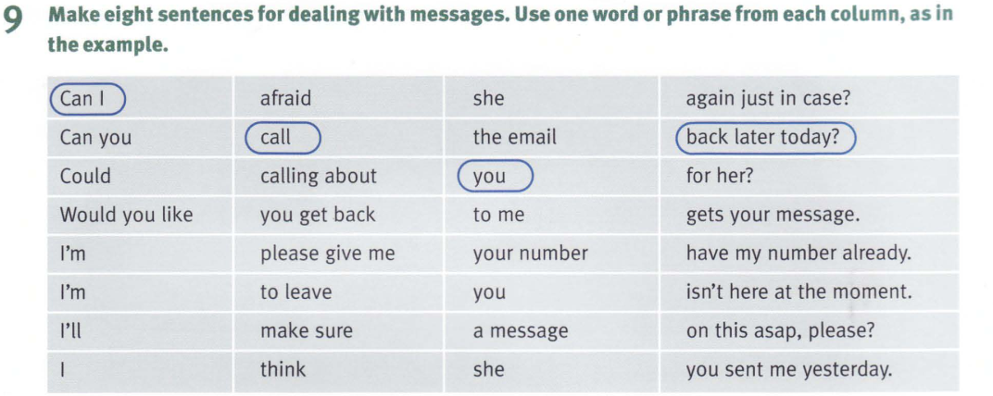

Slide 5
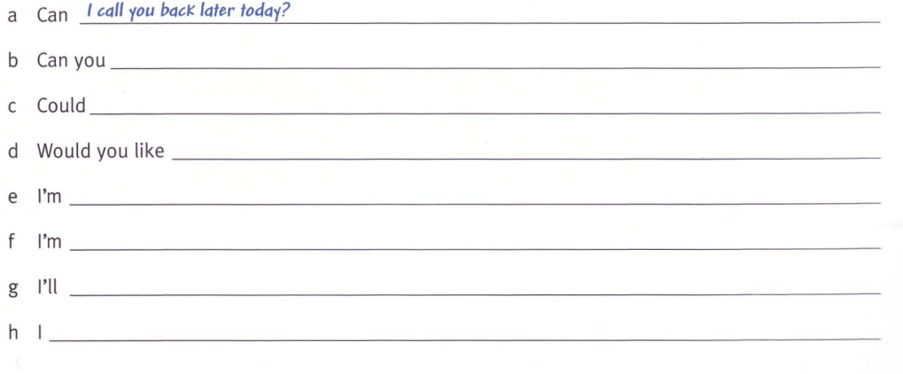
9.Make sentences

Slide 6
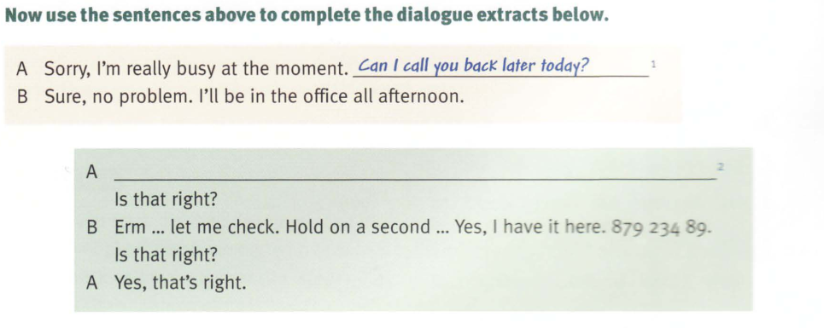

Slide 7
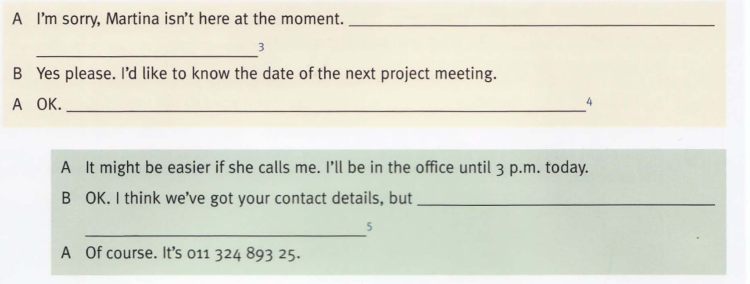

Slide 8
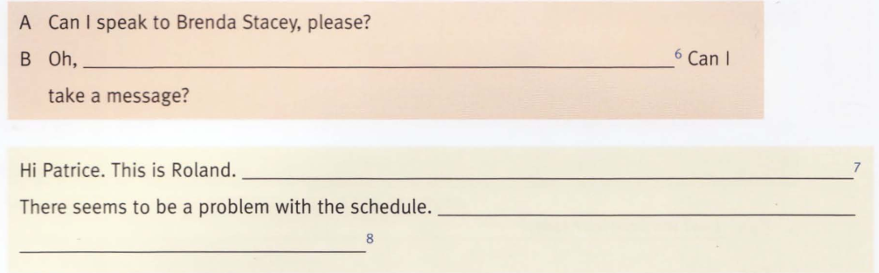

Slide 9
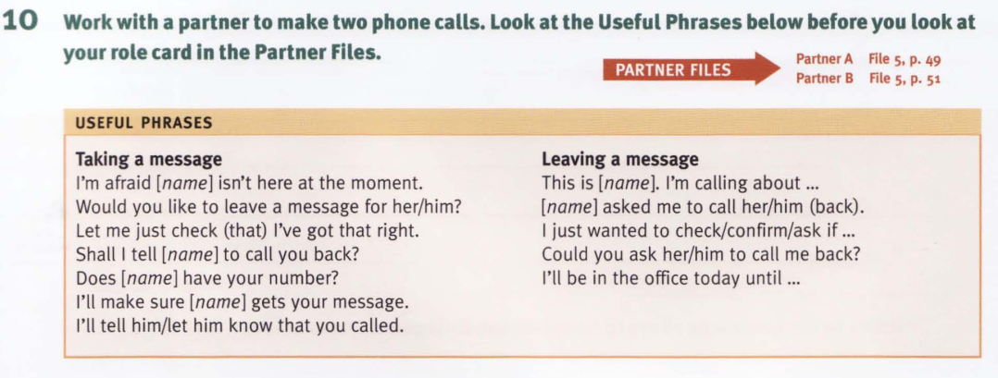

Slide 10
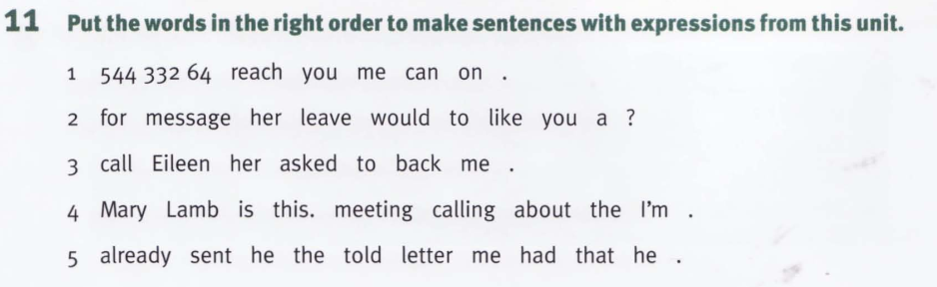

Slide 11
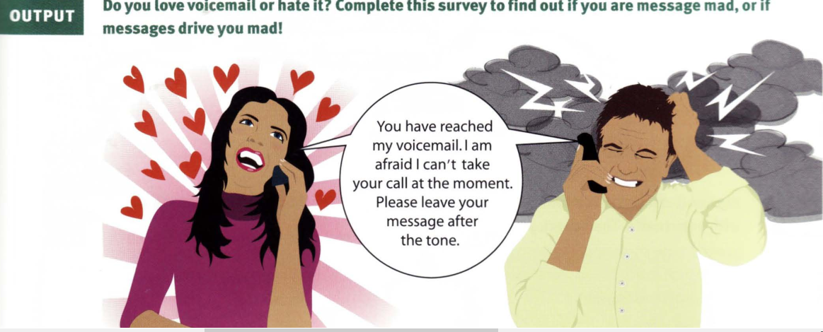

Slide 12
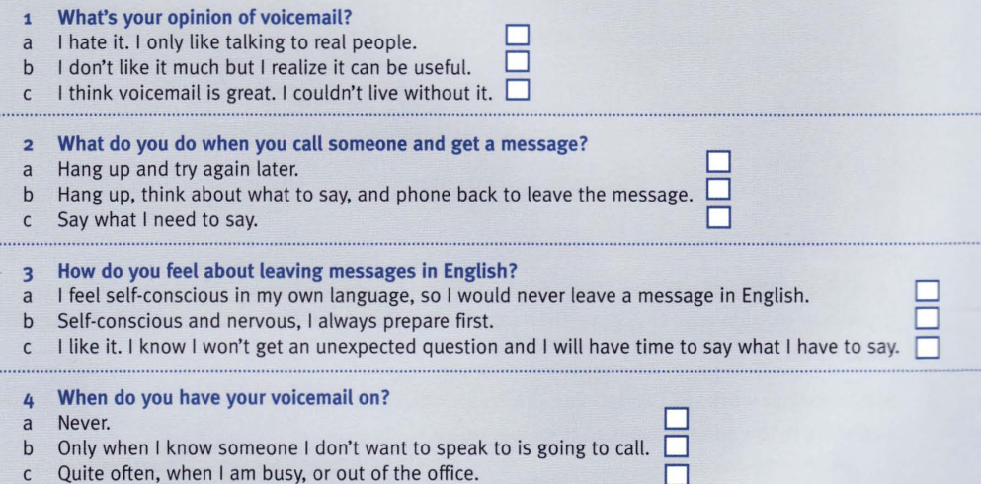

Slide 13
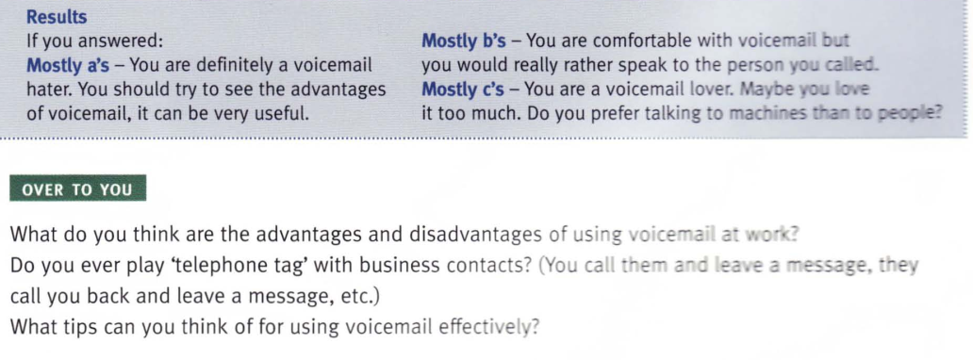

Slide 14
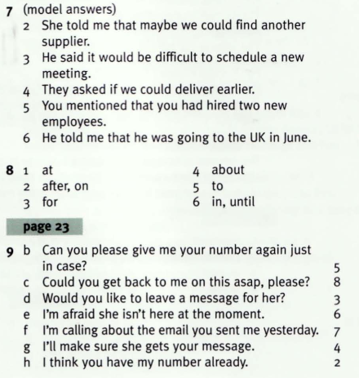
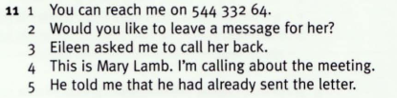
Answers:

Slide 15
Homework:
After these two periods you have to learn all vocabulary from unit 1 to unit 3.
Prepare for Revision and mid-term Test

